Slide 1
Spoken language identification with deep learning
Akiva Gubbay

Slide 2
Goal
The goal of this project is to develop a system that can identify the spoken language within an audio file(s) using varius deep learing techneques.

Slide 3
Dataset
Four languages were used: English, German, French and Spanish.
I train and tested the model on data from The VoxForge dataset.
The VoxForge dataset consists of multilingual speech samples available on the VoxForge website.
This dataset contains short speech samples. Given that the speech samples are recorded by users with their own microphones, quality varies significantly between different samples.
In contrast to song audio, which combines background music, instruments and the several singer’s voices into a complex mix. Each audio file in the dataset records one speaker that speaks in one language.

Slide 4
Feature extraction
The first step in any automatic speech recognition system is to extract features i.e. identify the components of the audio signal that are good for identifying the linguistic content and discarding redundant information like background noise.
Two approaches:
1) Spectrograms
2) MFCCs

Slide 5
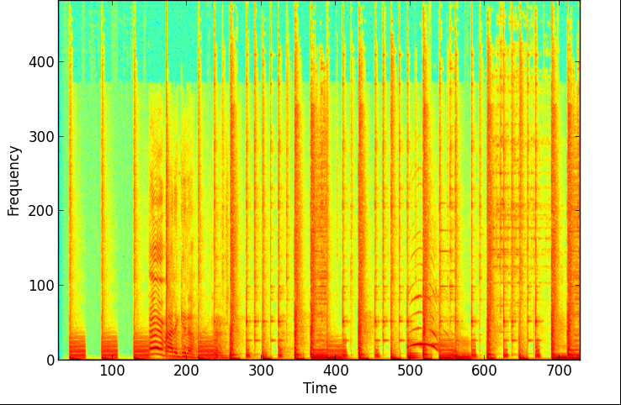
Spectrograms
Spectrograms are a visual representation of the audio signal.

Slide 6
MFCCs
Mel Frequency Cepstral Coefficients (MFCCs) are a feature widely used in automatic speech recognition.
39 coefficients
10-13 first coefficients used for human voice.
LibROSA python package.

Slide 7
Model
Recurrent neural network (RNN).
128 Bidirectional LSTM cells.
One fully connected layer after the rnn cells that results in two or four labels, depending on the number of languages used for training. The layer is activated using the ReLU function.
Dropout is preformed on the added layer.
Classification is done using SoftMax.
AdamOptimizer for the loss function.

Slide 8
Parameters
The values of these parameters were reached through (a lot a lot of) trial and error.
Batch:
Learning rate(alpha): 0.001 (usually). Varius according to: 1) amount of data 2) dropout.
Time: 80 (start – 50, end 130). Out of roughly 250.
Dropout: 0.6-0.9

Slide 9
Accuracy results
Languages | Number of Training files (per language) | Number of Testing files (per language) | Accuracy
GER, FRE | 150 | 100 | 77.5%
GER, FRE | 1500 | 100 | 68%
GER, FRE | 10000 | 5000 | 68.4%
ENG, GER, FRE, SPA | 1500 | 100 | 35%
ENG, GER, FRE, SPA | 1500 | 100 | 40%
ENG, GER, FRE, SPA | 10000 | 5000 | 37.2%

